Slide 1
AdventureWorks
Sales Performance Overview of 2003
Notes:
State the purpose: to review detailed sales performance in 2003 and discuss how it informs sales strategies.

Slide 2
Key Performance Indicators (2003 vs 2002) Total Sales Value Up by 36.19%, with Significant Growth in Orders Order Count Soars by 237%, While Average Order Value Drops by 59.59% Gross Profit Growth, but profit margin is lower side: 12.6 %
54.31M
12.44K
4.36K
36.19%
237%
-59.59%
Total Due
Orders Count
Average Order Value
28.54K
991
6.84M
-11.32%
-63.24%
30.83%
Average Order Value Offline
Average Order Value Online
Gross Profit 2003

Slide 3
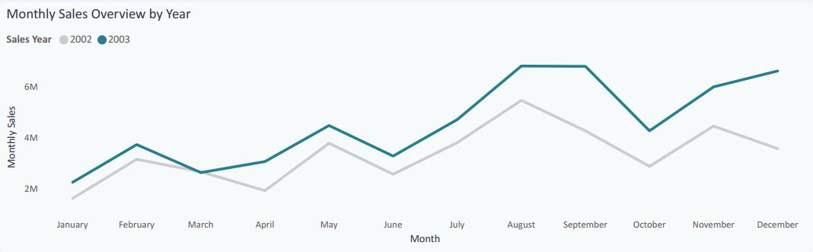
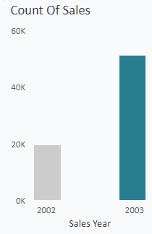
Steady Sales Growth with a Peak in Mid-2003 2003 Sales Volume Doubled Compared to 2002 Each Quarter Outperformed the Same Period in 2002
Period of Special Offers

Slide 4
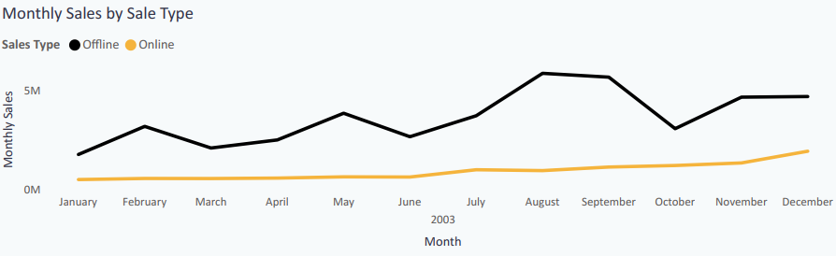
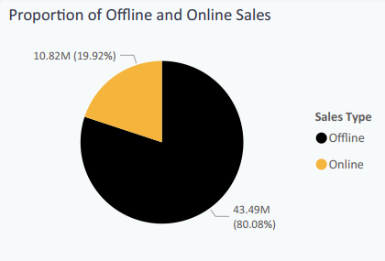
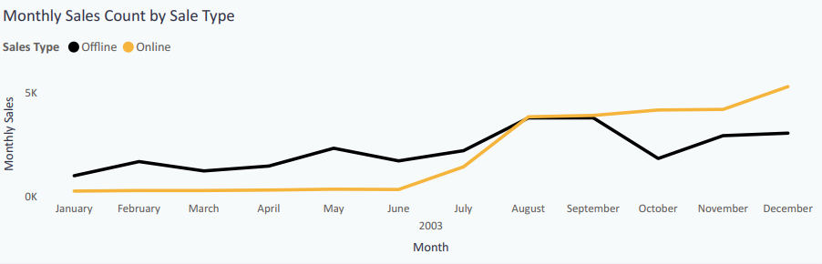
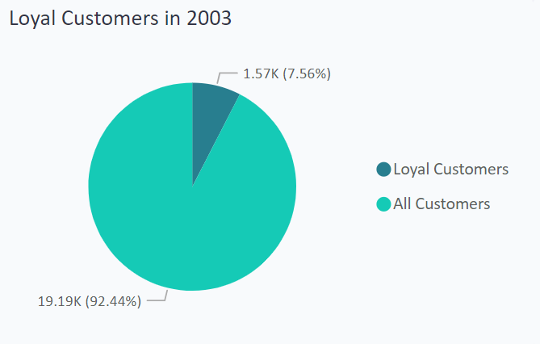
Online Sales Overtake, but Offline Holds 80% of 2003 Total Significant Online Increase Post-August, Yet Offline Sales Lead the Year Offline Sales Remain the Bulk Despite the Late-Year Online Surge
Period of Special Offers

Slide 5
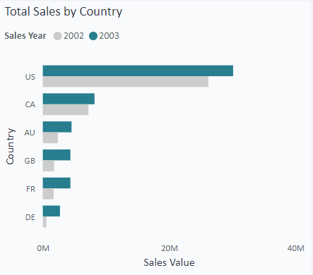
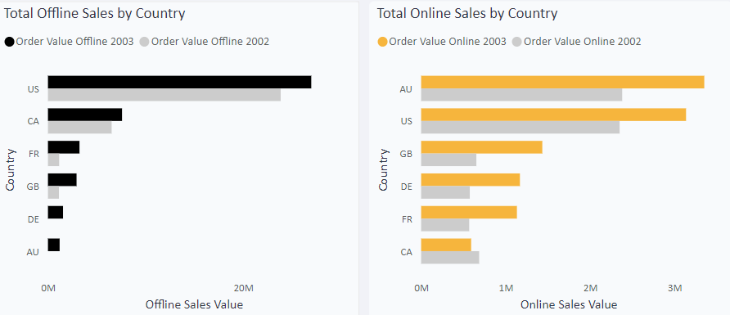
USA Leads Sales, But Australia Rises in Online Sales Offline Sales Mirror Overall Trend, with the USA Leading by a Wide Margin In 2003, Australia Emerges as the Online Sales Leader, Tied with the USA

Slide 6
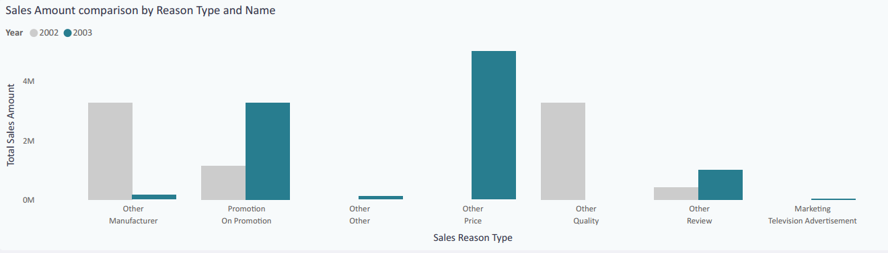
Consumer Shift: Price Sensitivity and Promotions in 2003 2002 Shoppers Valued Quality and Brand 2003 Shoppers Became More Price-Driven, Responding to Promotions

Slide 7
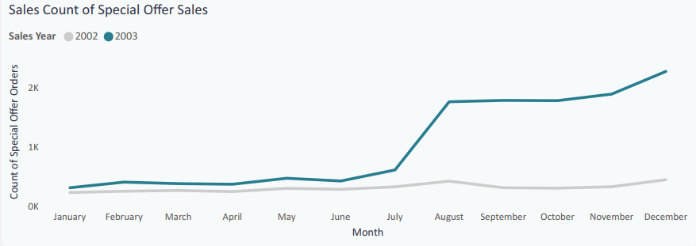
Special Offers: Key Driver of Sales Surge in 2003 Low Sales Until July, Followed by a Dramatic Rise in August By December, Special Offer Sales Count Hits 2,500, Far Surpassing 2002

Slide 8
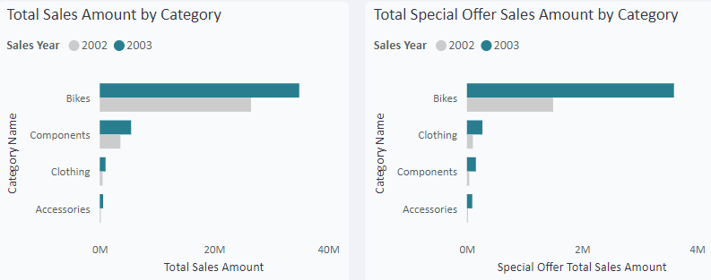
Dominance of Bike Sales in Both Overall and Special Offers Significant Year-over-Year Growth in All Categories Doubling Sales: The Big Impact of Special Offers on Bike Sales

Slide 9
Key Takeaways
Promotions Drive Sales
Seasonal and personalized promotions boost sales.
Significant impact on price-sensitive markets.
Online Sales Growth
Enhancing online experience and leveraging social media increases sales.
Offline sales still hold a major share.
Average Order Value
Need to address the decrease through upselling, cross-selling, and loyalty programs.
Product Category Performance
Bike sales are dominant; special offers positively impact this category.
Other categories underperforming.
Geographical Trends
USA leads in overall sales; Australia shows strong online sales growth.

Slide 10
Next Steps
Implement Targeted Promotions
Enhance Online Sales Channels
Increase Average Order Value
Focus on High-Performing Categories
Tailor Marketing Strategies by Region

